Slide 1
Constitutional Convention 1787
AIM: How did the Constitution address the problems of the Articles of Confederation?

Slide 2
Legislation
A unicameral legislature with each state having one vote regardless of size or population
Great Compromise: a BICAMERAL legislature with each state having equal representation in Senate and according to population in the House of Representatives (some feared the unruly nature of the masses)
3/5ths Compromise: slaves would be counted as 3/5ths for taxation and representation
(Legitimizes slavery)

Slide 3
Executive
No executive to administer and enforce acts of Congress
A President as chief of executive of the nation
Electoral College-must win a majority of a states popular vote to win its electoral votes

Slide 4
Judicial
No national court system
“The voice of the people has been said to be the voice of God; gut it is not true in fact. The people are turbulent and changing, they seldom judge or determine right…Can a democratic assembly who annually revolve in the mass of the people, be supposed steadily to pursue the public good? Nothing but a permanent body can check the imprudence of democracy”.. Alexander Hamilton
A national system of courts, headed by the United States Supreme Court (meant to check the power of the masses)
No real power until Marbury v. Madison 1803

Slide 5
Lawmaking ability
Enactment of legislation required nine out of 13 votes
Enactment of legislation by a simple majority in each house of Congress

Slide 6
Power to tax
Congress had no power to levy and collect taxes or duties
Congress has the power to levy taxes and establish duties on imports (tariffs)
No export taxes allowed

Slide 7
Trade
Congress had no power to regulate trade
Congress has the power to regulate interstate and foreign commerce

Slide 8
Amending the Constitution
Articles could be amended only by the consent of all states
The Constitution can be amended by proposals passed by 2/3rds vote of both houses of Congress or by a national convention and ratified by 3/4th states

Slide 9
Power of the Federal Government
The Articles represented only a “firm league of friendship” among the states
The Constitution is the supreme law of the land

Slide 10
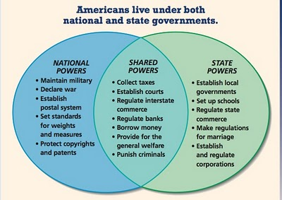
Federalism: division of power between the federal gov’t and the states

Slide 11
How much power should the federal government have??
“Government is not the solution to our problem, government is the problem.” Ronald Reagan
“The solution to these problems does not rest on a massive program in Washington, nor can it rely solely on the strained resources of local authority. They require us to create new concepts of cooperation, a creative federalism, between the National Capital and the leaders of local communities”.. Lyndon Johnson

Slide 12
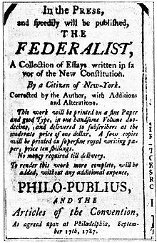
Development of First Political Parties
Federalists – support a strong central government over states rights, manufacturing, a $ future with England
The Federalists Papers
Anti-Federalists – oppose a strong central gov’t and support states rights, farmers, revolution in France

Slide 13
Anti-Federalist Argument
Too much power in national government at expense of the states
Executive branch has too much power
“Necessary and Proper” clause gives Congress too much power
Standing army in peacetime
Does not have a Bill of Rights
Meeting was done in secret not public

Slide 14
Federalist Argument
Strong National government
It IS possible to govern over so large a territory
Rights protected by checks and balances, separation of powers
House – protects local interests, Senate – protects state interests
President protect national interests, elected by electoral college
Sup Ct. protect fundamental rights
Bill of Rights unnecessary because governments’ power is limited

Slide 15
Led to First political parties
Federalists and Democratic-Republicans
agriculture v. manufacturing
ally ourselves with France or England?
Federal Supremacy v. States Rights

Slide 16
Impact today……
--------------------------------------------------------------------------------------------------
CYCLICAL NATURE OF OUR POLITICAL SYSTEM FROM PERIODS WHERE THE FEDERAL GOVERNMENT EXPANDS ITS POWER TO PERIODS WHEN IT SHRINKS ITS ROLE

