Slide 1
Topic: Intro to Sociology
AIM: How does a sociological imagination allow us to understand society and ourselves better?

Slide 2
I. The Sociological Point of View
Sociology – the science that studies human society and social behavior
1. Social Interaction
2. Focus on group rather then individual
3. Society – a large social grouping that the same geographical territory,
political authority and dominant
cultural expectations.

Slide 3
B. Why Study Sociology?
Sociological Perspective: allows us to view the world without bias

Slide 4
2. Social Factors effect on Behavior

Slide 5
3. Empathy

Slide 6
4. Balance Personal Desire with Demands of Society

Slide 7
5. Social Animals

Slide 8
6. Sociological Imagination
a. gives people insights into how their social environment shapes them, and how they can shape their social environment.
All human actions are related to past social events in some way

Slide 10
DURKHEIM’S STUDY OF SUICIDE (1897)
MORE LIKELY TO COMMIT
MALE PROTESTANTS WHO WERE WEALTHY AND UNMARRIED HAD HIGHER SUICIDE RATES
PROTESTANTISM AND INDIVDUALISM
LESS LIKELY TO COMMIT
MALE JEWS AND CATHOLICS WHO WERE POOR AND MARRIED
BEING CATHOLIC AND GROUP-ORIENTATION
ONE OF THE BASIC FINDINGS: WHY?
THE DIFFERENCES BETWEEN THESE GROUPS HAD TO DO WITH “SOCIAL INTEGRATION”
THOSE WITH STRONG SOCIAL TIES HAD LESS OF A CHANCE OF COMMITING SUICIDE
Still relevant?

Slide 11
C. Methods of Comparison
Sociologists make comparisons between groups.
Society v. Society
Subgroup v. Subgroup

Slide 13
D. Why take Sociology?
There is an URGENCY and importance to understand society.
The World is More complex it needs:
More Well Rounded People
More appreciation for diversity

Slide 15
II. Social Sciences
Anthropology: comparative study of past and present cultures
Cultural Anthropologists - study different aspects of culture in society.

Slide 16
B. Psychology
Deals with the behavior and thinking of organisms
Focuses on the individual rather then group
Social Psychology- study of how an individual’s behavior and personality are affected by the social environment

Slide 17
C. Economics
The study of the choices people make in an effort to satisfy their wants and needs.
Is related to sociology in some ways because sociologist tend to look at how economic facts affect the lives of various groups in society.

Slide 18
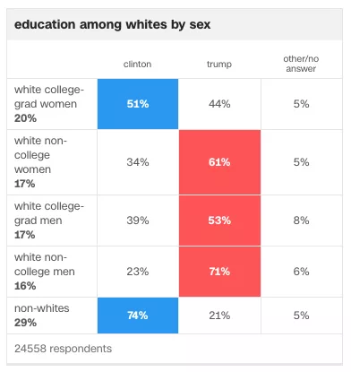
D. Political Science
Examines the organization and operation of governments
Voting patterns of groups, political parties

Slide 19
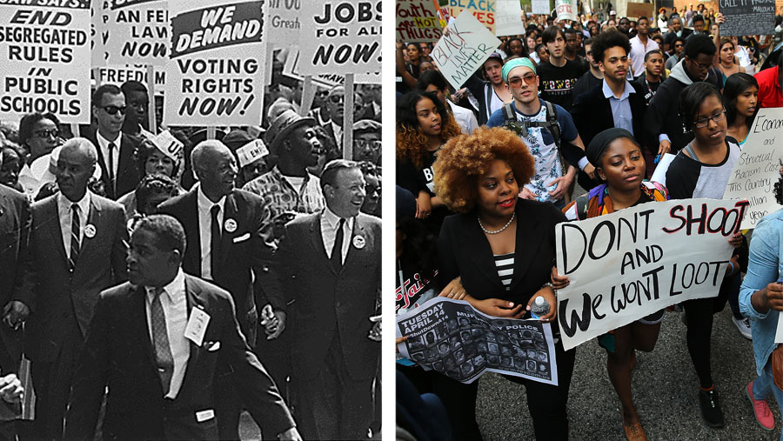
E. History
The study of past events
Sociologists use history to explain current social behaviors

Slide 20
III. How can sociology help us?
Sociologists try to come up with explanations for some of societies BIGGEST questions and problems:
Inequality
Deviance
Group Dynamics
Relationships
Conflict
Connections

