Slide 1
Mid Term Review

Slide 2
Period 1: 1491-1607

Slide 4
Period 2: 1607-1754

Slide 6
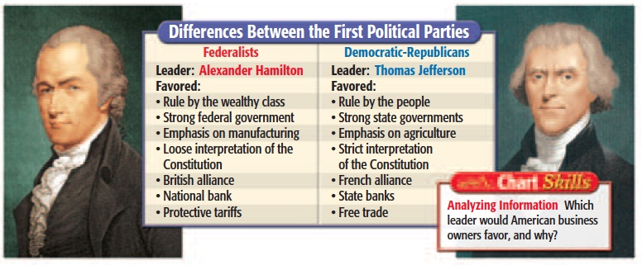
Period 3: 1754-1800

Slide 8
Period 4: 1800-1848

Slide 10
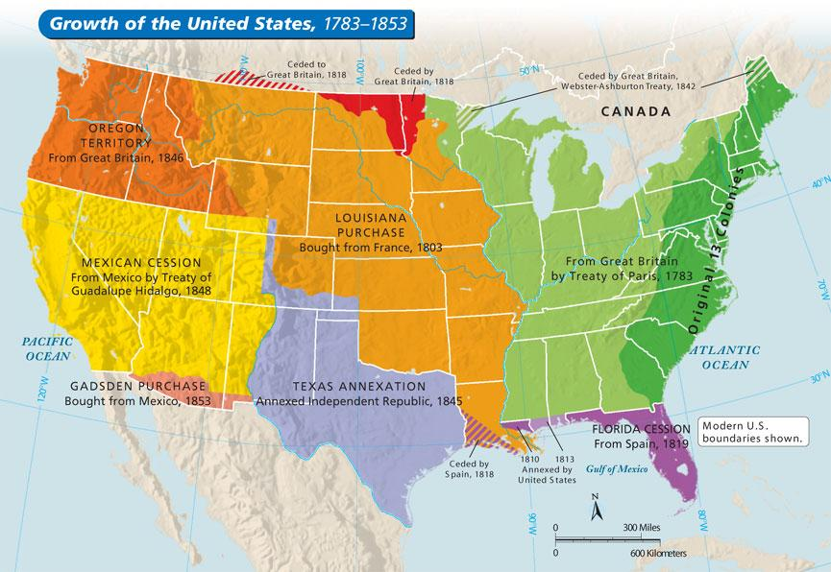
Period 5: 1844-1877

