Slide 1
The Market Revolution
AIM: What factors aided in the development of a market economy in the early 19th century?

Slide 2
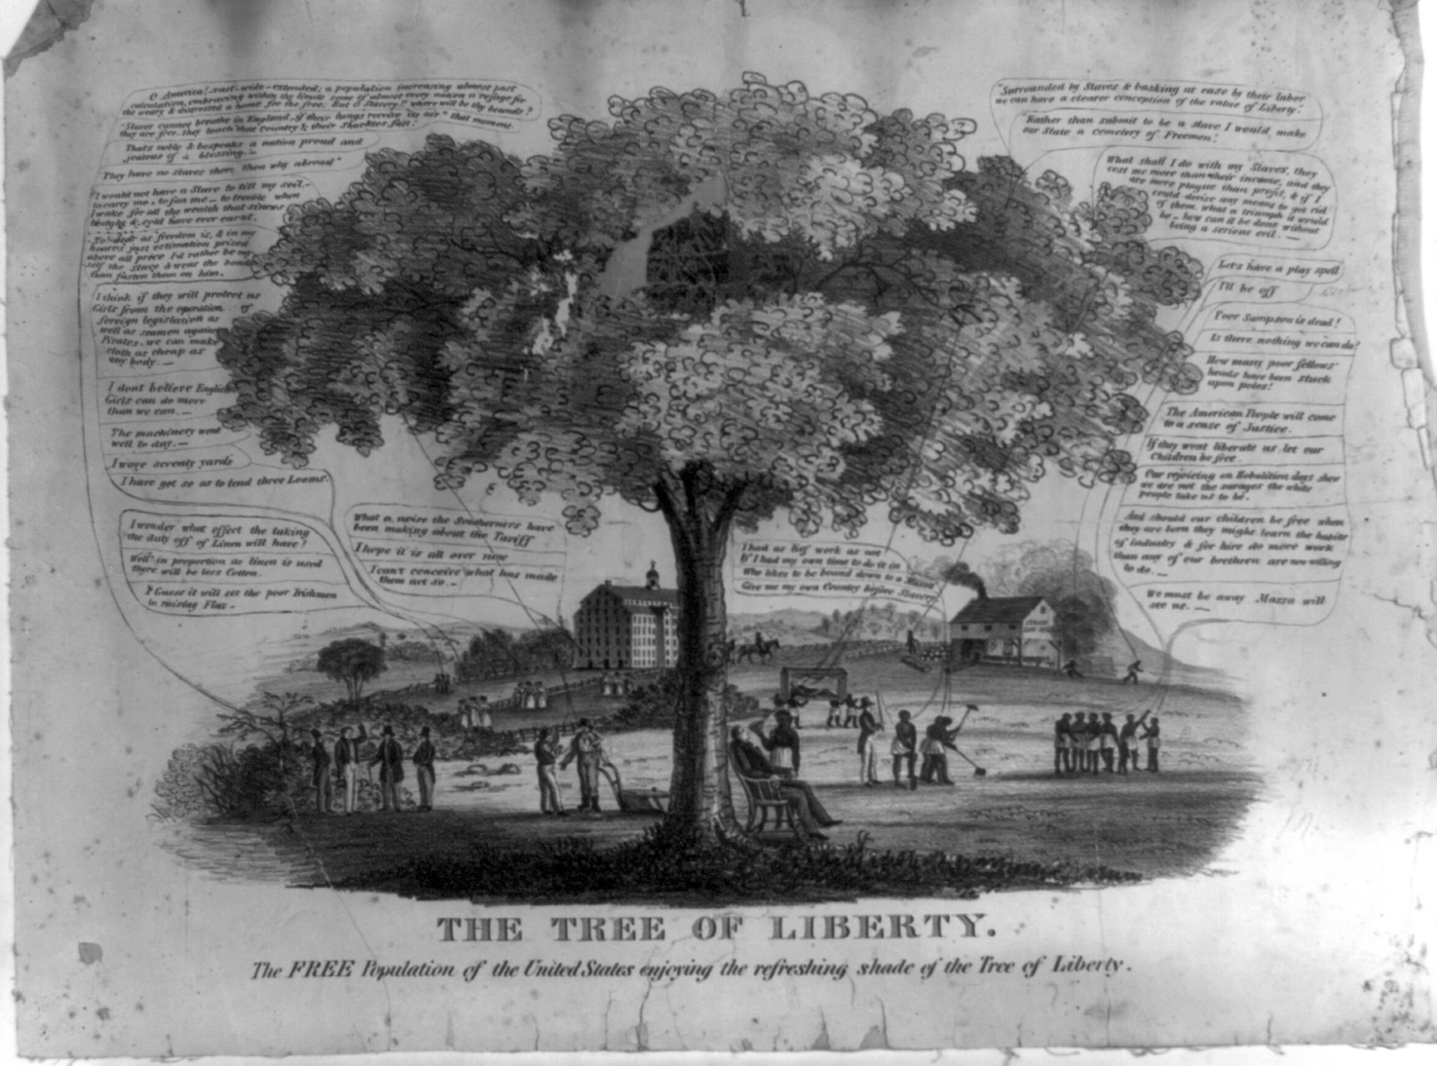
2 Visions of America, A History of the United States
Notes:
Chapter Opener: The Tree of Liberty (page 253)
Text Excerpt: This image, The Tree of Liberty (1846), illustrates the radical differences between the vision of liberty defended by Northern proponents of free labor and that of Southern defenders of slavery. On the right side of the tree, a slaveholder reclining in a chair while fanned by a slave announces, “Surrounded by slaves & basking at ease by their labor we can have a clearer conception of the value of liberty.” On the other side of the tree, the artist has placed two industrious farmers conversing, and young mill women in front of their factory.
Background: The Tree of Liberty is a complex image that contrasts the world of Northern free labor with Southern slavery. Much of the discussion occurring in the image—particularly on the side depicting free labor—focuses on the issue of tariffs and their impact on Northern industry and agriculture. The artist has included a mill, and a group of mill girls. The abolitionist sympathies of the artist are also evident. One of the farmers conversing on the lower left states emphatically that “No! dear as freedom is, & in my heart's just estimation prized above all price I'd rather be myself the slave & wear the bonds than fasten them on him.” On the opposing side, scenes of Southern dissipation and tyranny abound. A slaveholder reclines in a chair while his slave fans him. Another master stands with a whip in hand ready to discipline his bondsmen.
Chapter Connections: The focus of this image is on the radically different economic worlds of the North and the South. Factory work—including the new labor source, mill girls—is prominently featured. Commercial agriculture is contrasted with slave labor. A group of men boast that “O America! vast—wide—extended; a population increasing almost past calculation, embracing within thy limits some of almost every nation; a refuge for the weary & distressed a home for the free.” Immigration provided one source of cheap labor, an essential ingredient of the North's economic prosperity. Although this artist's abolitionist views lead him to cast Northerners as champions of freedom and Southerners as supporters of despotism, Southerners viewed their own system as no less committed to American ideals of freedom. Indeed, one Southerner expressly states his view that the freedom from want that his slaves provide allows him to have an even better understanding of liberty than those in the North.
Discussion Questions:
What symbols of Northern free labor does the artist include?
How is Southern slavery portrayed?

Slide 3
Towards a republican culture
North
wanted to extend republican principles to capitalism, family and social relationships
South
aristocratic republicanism; liberty for whites over equality for all

Slide 4
Divergent Paths
Due to the “Market Revolution,” the North developed an economy centered on industry, commerce and wage laborers
Thanks to “King Cotton,” the South grew more and more to rely on slave labor to underpin its way of life
Impact of Eli Whitney’s “Cotton Gin” 1790

Slide 5
Population Density

Slide 6
Transportation and public enterprise
State governments granted charters to private turnpike companies and for water transport
Debate over “common wealth” system – state aid to private businesses that would improve the general welfare

Slide 7
The Market Revolution
A set of interrelated developments in agriculture, technology, and industry that led to the creation of a more integrated national economy.
Impersonal market forces impelled the maximization of production of agricultural products and manufactured goods and increased consumption.
7 Visions of America, A History of the United States

Slide 8
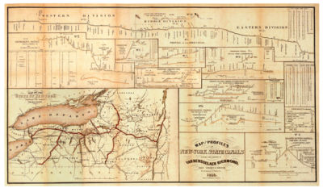
Market Revolution
Increased commercialism and rise of factories
New methods of transportation linked West to manufacturing of the East.
Canals and turnpikes developed
Combination of public and private financing
1853 Map of the Erie Canal

Slide 9
American Industry
Two great changes:
Growth and mechanization of industry
Division of labor
Interchangeable parts
Factory System
Improved technology
“Waltham Plan” – factories and dorms
Expansion and integration of markets

Slide 10
From Artisan to Worker
Artisan Production
A system of manufacturing goods, built around apprenticeship, that defined the preindustrial economy.
The apprentice learned a trade under the guidance of an artisan who often housed, clothed, and fed the apprentice.
Industrial Production
Outside the home
Unskilled
Depersonalized
10 Visions of America, A History of the United States

Slide 11
Impact on Labor
Workers challenged the transition from artisan to wage laborer
Unions develop, though technically illegal
“Labor Theory of Value”
Overproduction leads to layoffs – “business cycle”
Ex. Panic of 1819
1836 Song Lyrics Sung by Protesting Workers at Lowell
Oh! isn't it a pity, such a pretty girl as I Should be sent to the factory to pine away and die? Oh! I cannot be a slave, I will not be a slave, For I'm so fond of liberty, That I cannot be a slave.

Slide 12
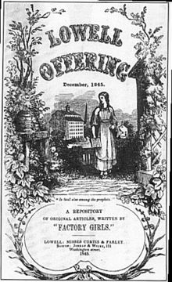
Lowell Mills
Young, unmarried white women moved to Lowell to work, live in boarding house
Owners enforced strict curfews, church attendance and banned alcoholic beverages
In 1840s, replaced by Irish immigrants

Slide 13
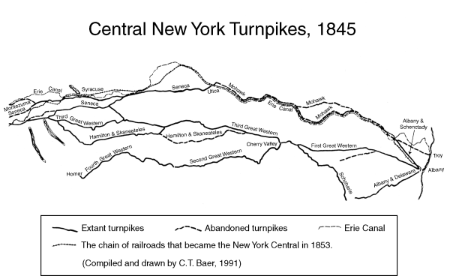
Transportation Revolution
States chartered private companies to build toll roads
National Road from Virginia to Illinois
Debate over who funds “internal improvements”
Erie Canal – first great engineering project; environmental impact
Steamboat contributes to economic growth of Midwest
Upstream travel; Robert Fulton
Early phase of railroad boom – greater impact post-Civil War

Slide 14
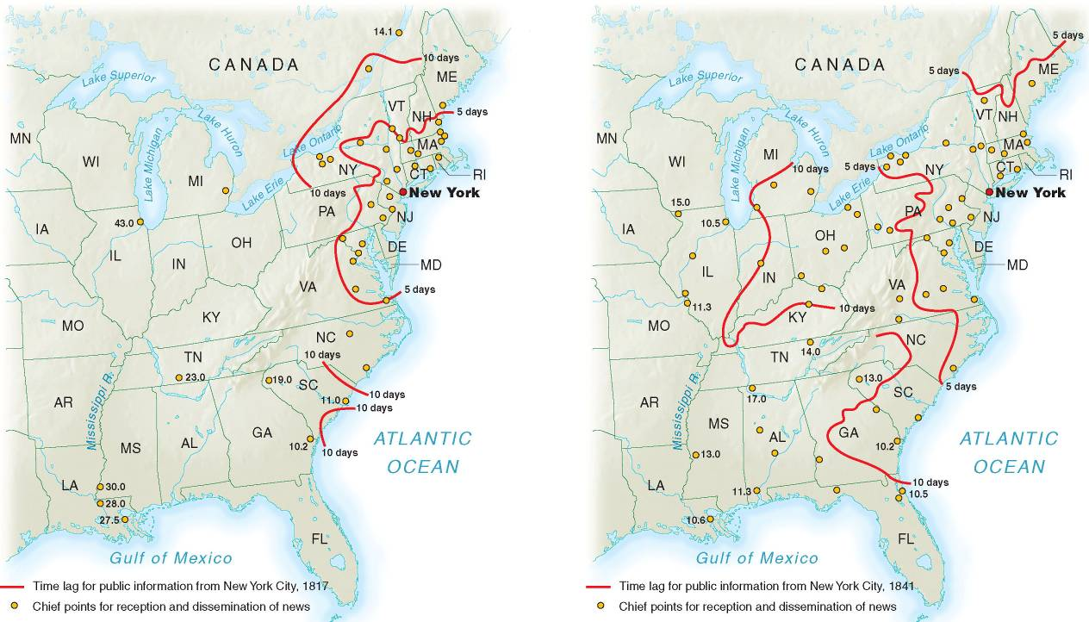
Improvements in Communication
14 Visions of America, A History of the United States
Notes:
9.3 Time Lag for News 1800–1841
Improvements in communication technology and transportation dramatically reduced the time it took for news to travel from the coastal cities to the interior cities.

Slide 15
Growth of Cities
Cities grew along rivers as mill owners exploited water power
E.g., Hartford
Western commercial cities grew where goods were transferred from one mode of transport to another
E.g., Pittsburgh
Old Atlantic seaports remained important for foreign commerce and as financial centers
E.g., New York City
Pittsburgh c.1900

Slide 16
Changing Social Order
New Industrial Order created distinct social classes
Wealthy increasingly set themselves apart
Middle Class developed – characterization of “self-made man”
Urban poor congregated in separate areas, sought solace in alcohol
Government policies facilitated the accumulation of wealth
John Jacob Astor
Dogfight at Kit Burns

Slide 17
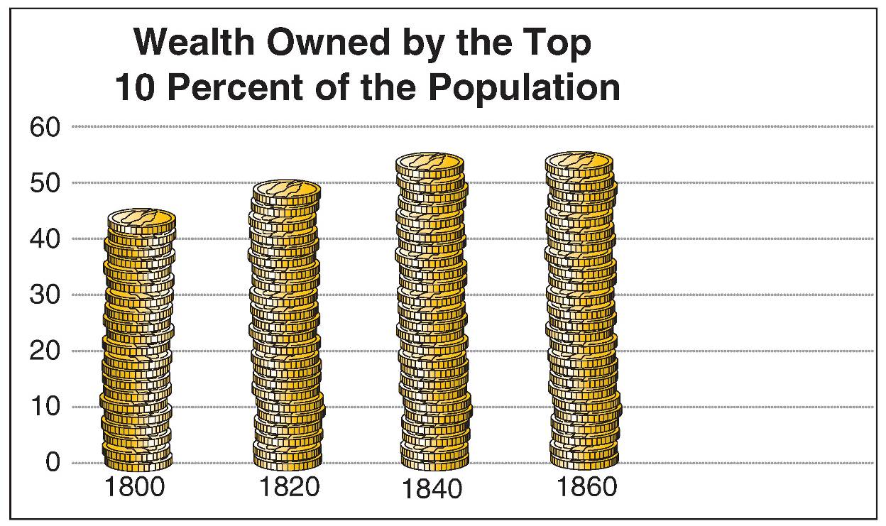
17 Visions of America, A History of the United States
Notes:
9.6 Wealth Stratification
As the nation’s wealth grew during the first half of the nineteenth century, it became more concentrated in fewer hands. The rich controlled an even larger percentage of the nation’s wealth mid-century.

Slide 18
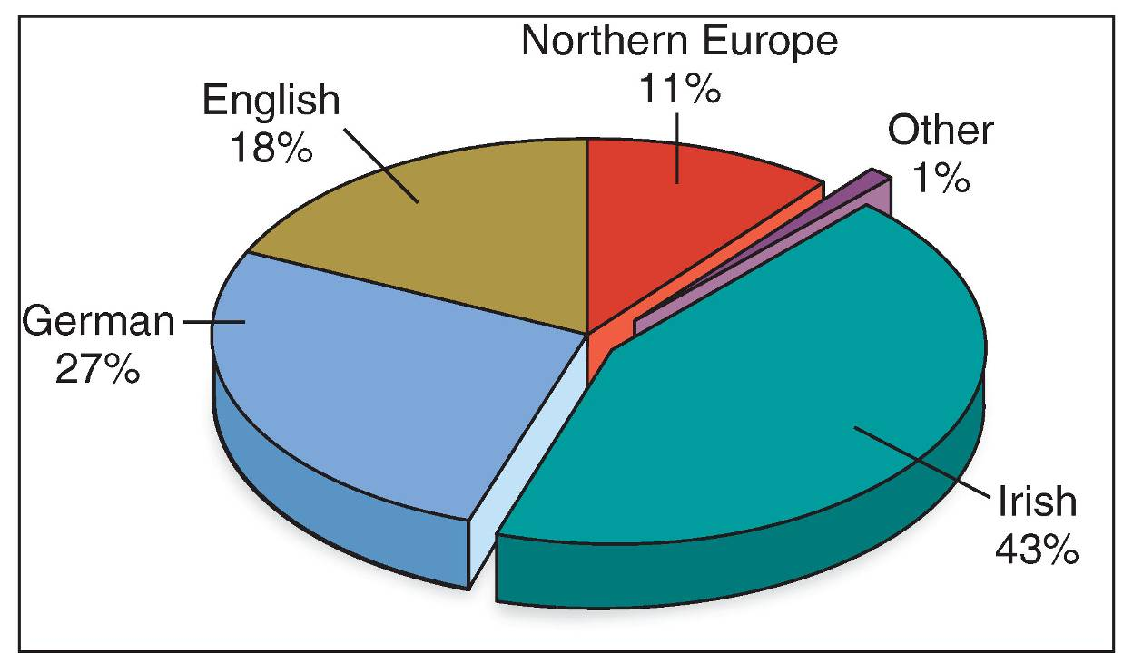
Immigration Trends
18 Visions of America, A History of the United States
Notes:
Image 9.9: Sources of European Immigration
Immigrants from Germany and Ireland changed the population mix in much of the nation. The influx of Catholic immigrants in particular resulted in tensions with Protestants.

Slide 19
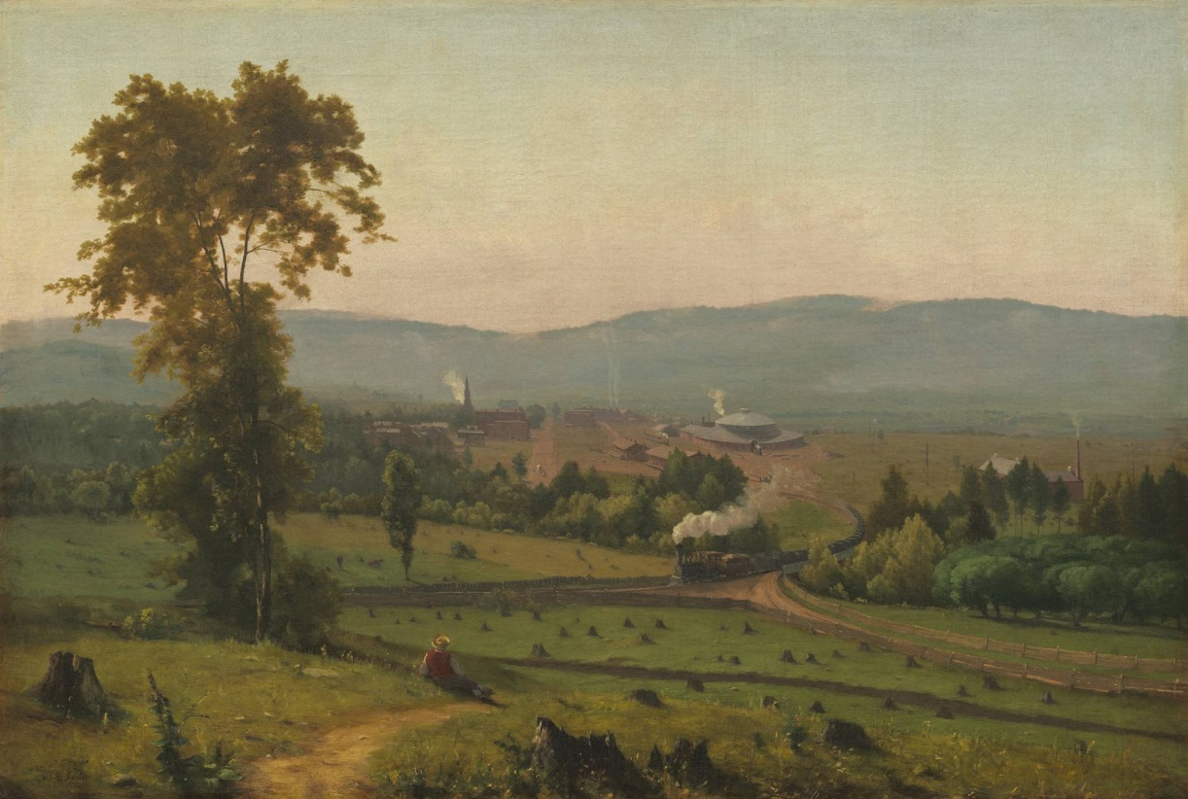
Images as History
Nature, Technology, and the Railroad: George’s Inness’s The Lackawanna Valley (1855)
How did George Inness view technological progress in his paintings of the Lackawanna Valley?

Slide 20
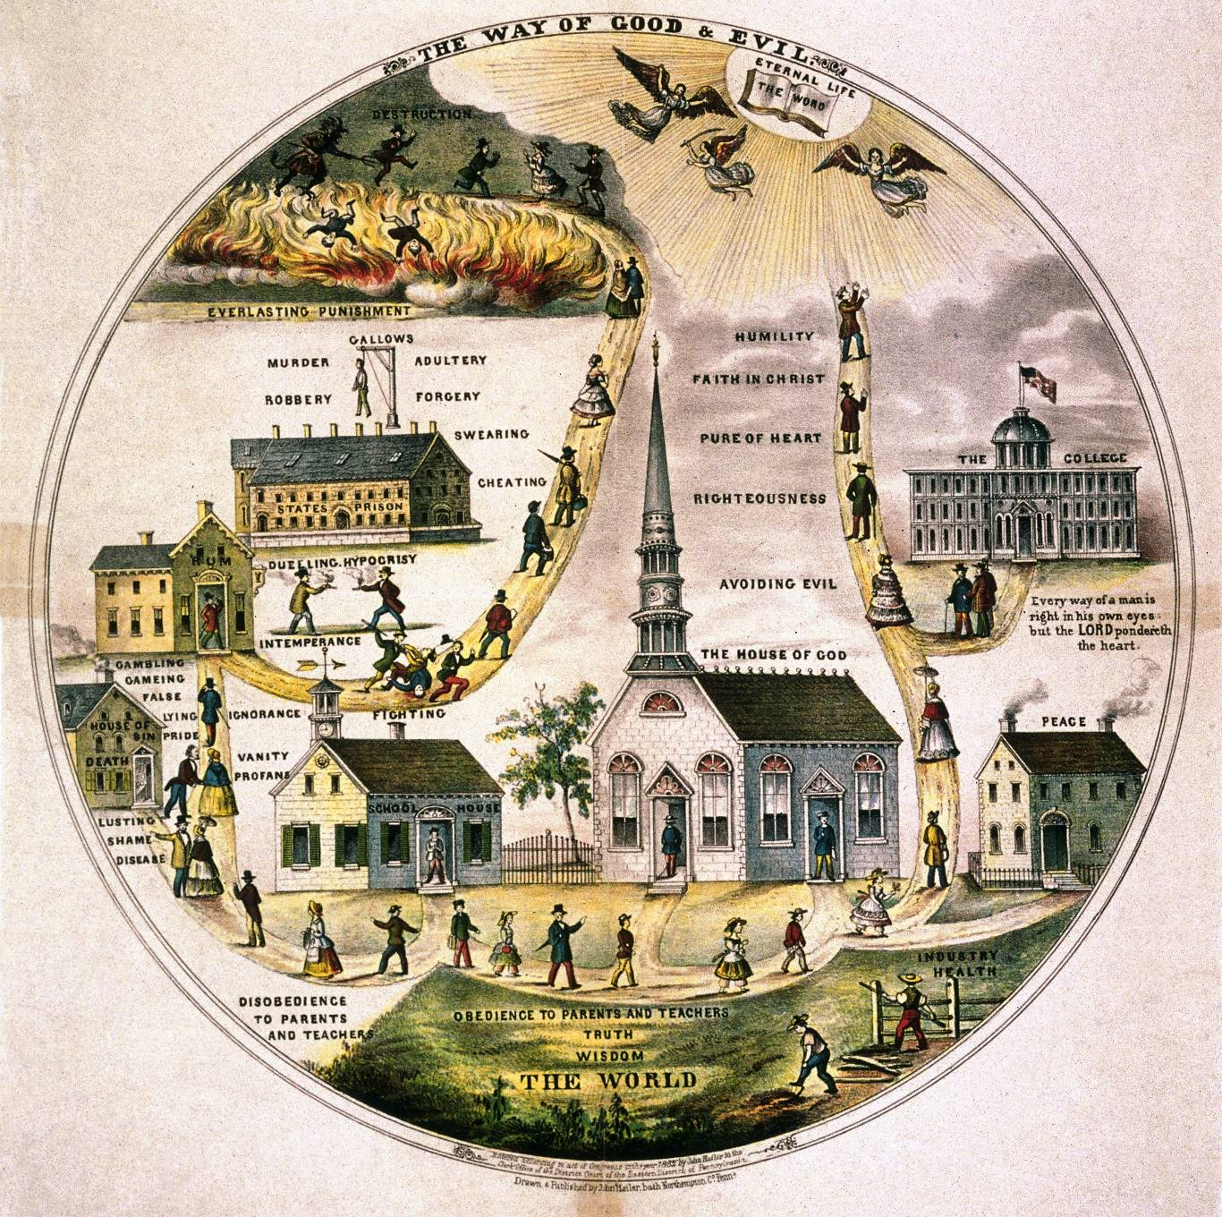
Notes:
Chapter Opener: “The Way of Good and Evil” (page 283)
Text Excerpt: The expansion of democracy and the changes resulting from the market revolution left Americans concerned about their lives and the nation’s future. Rising inequality and a bitter debate over slavery intensified anxieties. In this popular lithograph, “The Way of Good and Evil”, the artist portrays the social ills facing America, including alcoholism, prostitution, and crime. A tavern, brothel, and prison represent the path of destruction. Different buildings—a school, home, and church—anchor the center. The path to salvation leads from these institutions through college and eventually up into heaven. In the artist’s view, Americans faced a clear choice: salvation or eternal damnation.
Background: The popular image “The Way of Good and Evil” reflects the hopes and aspirations of reform-minded Americans during the period after the Great Awakening and before the Civil War. The image presents two opposing paths—one leading to salvation and the other leading to damnation. The rapid changes wrought by the market revolution and the rise of Jacksonian democracy left many Americans feeling that the nation had veered away from its core values. At the same time, the tools provided by the market and the techniques developed in American politics to reach the American people were used by reformers to spread their message. A variety of different religious and secular reform movements emerged in this period to deal with these social ills and offered a host of different solutions to combat these problems. In many cases the solutions to these social problems required changes in institutions, including churches and schools. Reformers also turned to architecture hoping that changes in the built environment would further the cause of reform.
Chapter Connections: Among the most prominent evils depicted in this image are prostitution and alcoholism. Both of these issues attracted considerable attention from reformers. The notion that life was a journey along a path was a popular metaphor that shaped everything from the plot lines of many popular novels to the new board games created during this period. Novelists appealing to a mass audience presented tales in which their lead characters endured the trials and tribulations of a world filled with temptations. Choosing the correct path could mean the difference between salvation and ruin. The same underlying metaphor also influenced the creators of the first board games, such as “The Mansion of Happiness”. Designed to instill values such as chastity, religiosity, and hard work, players of the game moved forward if they landed on virtues and were sent backward if they landed on vices such as alcoholism.
Discussion Questions:
In addition to prostitution and alcoholism, what other social evils depicted in this image threatened America?
What role does education play in the “The Way of Good and Evil”?
What role does religion play in the “The Way of Good and Evil”?

Slide 21
Benefits
Cheaper Products
Employment
Negative Effects
Loss of Artisan skills
Exploitation of women, children and immigrants
Uneven distribution of wealth
Urbanization: problems
Rise of Nativism – Know Nothing party

