Slide 1
Three Main Sociological Perspectives
AIM: How do sociological perspectives help us to understand society?

Slide 2
Sociological Imagination
Sociologists C. Wright Mills – “the vivid awareness of the relationship between private experience and the wider society.”
Ability to make connections between yourself and the wider world
Example: Tea Drinking

Slide 3
Sociological Perspective
Looking at society systematically in a scientific way to identify patterns and connections

Slide 4
Levels of Sociological Examination
Macrosociology
Looks at Society as a whole on a large scale.
Examines long term effects
Microsociology
Looks at Society on an individual or small scale
Examines day to day interactions
Globalization
Examines global impacts and connections

Slide 5
Theoretical Perspective:
Sociologists develop theories of how societies work in order to test them
Groups of similar theories can be divided into three main perspectives of looking at society
Functional
Conflict
Symbolic

Slide 6
Conflict Perspective
Developed by Karl Marx
Different groups compete for POWER and RESOURCES
Once certain groups gain power they pass laws to keep that power at expense of others
Focuses heavily on inequality and uneven distribution of power and wealth

Slide 7
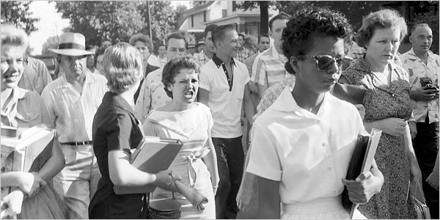
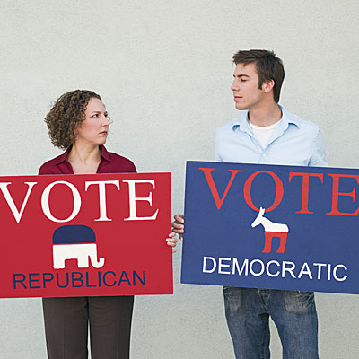
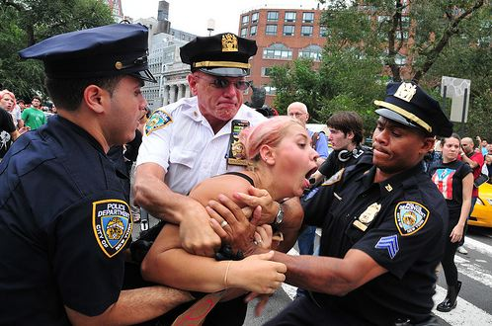
Factors that cause competition & change
How do people exercise control over others?
Causes – Reasons for conflict?

Slide 8
Functional Perspective
Developed by Emile Durkheim
View society as a set of interrelated parts that work together to produce a stable social system
Believe society is held together by “consensus” – everyone agrees what’s best
Not everything in society runs smoothly…….

Slide 9
Dysfunction: the negative consequence on social system
Manifest Function: intended or recognized consequence of some element on society
Latent Function: the unintended or unrecognized consequence
Functional Equivalent: some features of society may have a substitute

Slide 10
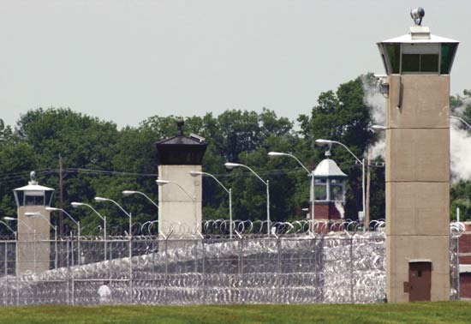
What purpose/function does something serve for/in society?

Slide 11
Symbolic/ Interactionists Perspective
Developed by Max Weber
Focus on how individual interact with one another in every day situations
What meanings do individuals attach to their own actions and the actions of others
Symbolic is anything that has a larger meaning than just itself
Ex. Sports car as a symbol for youth

Slide 12
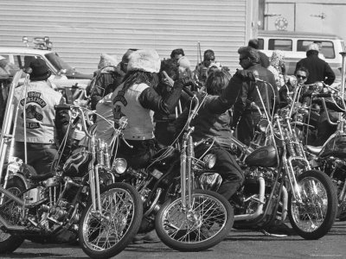
How do people interact with each other in society?
in different situations & relationships
Rules for interaction?

